Slide 1
10
Reasons Russia
Invaded Ukraine

Slide 2
PRETEXT
First, let’s start with the

Slide 3
1
Demographics of
Ukraine/Crimea

Slide 4
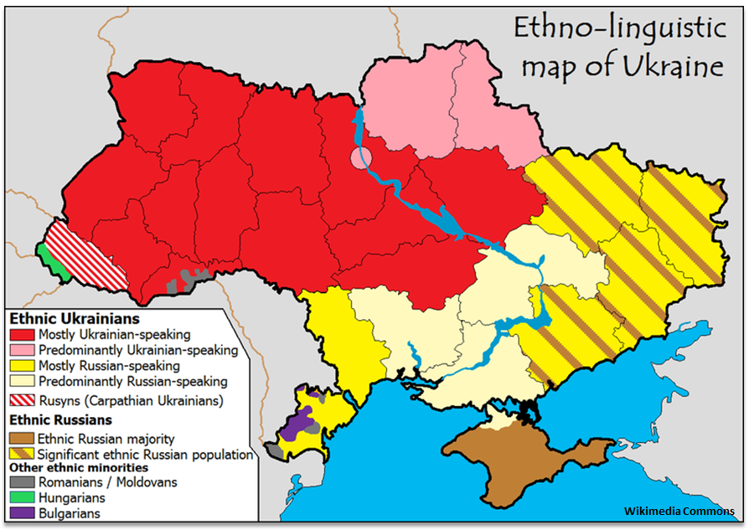
Ukraine, and particularly the Crimean Peninsula,
has large Russian populations that
Vladimir Putin claims to be protecting.
“I reiterate, we are talking about protecting our citizens and compatriots, about protecting the most fundamental human right – the right to live and nothing more.”
- Russian foreign minister

Slide 5
OK, so now onto the
REAL REASONS

Slide 6
2
Geography of the
Crimean Peninsula

Slide 7
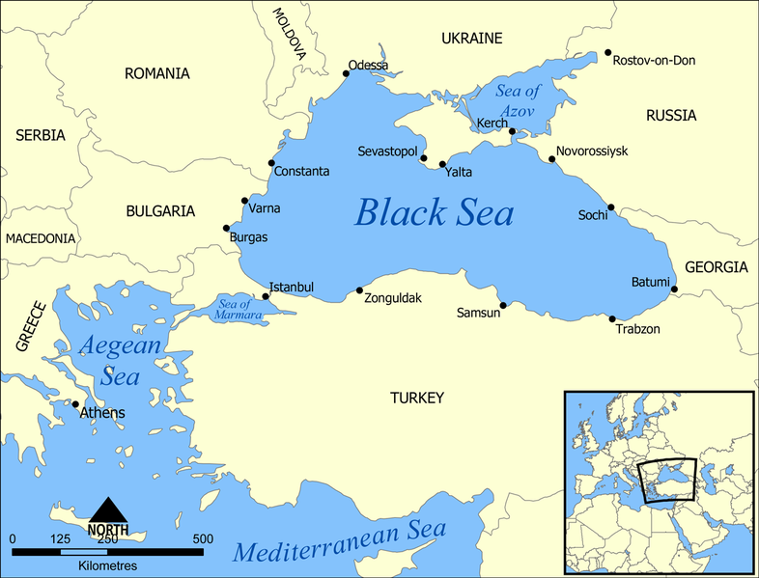
Russia views the
Crimean Peninsula
Crimean Peninsula
as strategically important.
Russia’s only WARM WATER NAVAL BASE is in Sevastopol.
And Crimea serves as a CHOKE POINT to and from the Sea of Azoz.

Slide 8
3
Location of Ukraine

Slide 9
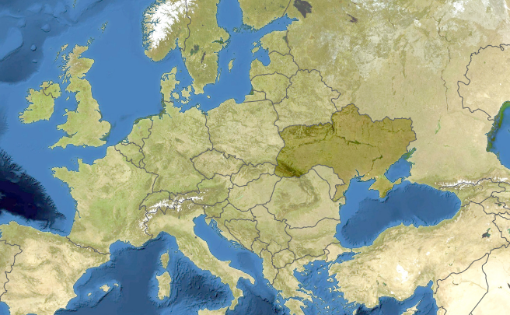
That right there is Ukraine, SANDWICHED B/W RUSSIA AND EUROPE

Slide 10
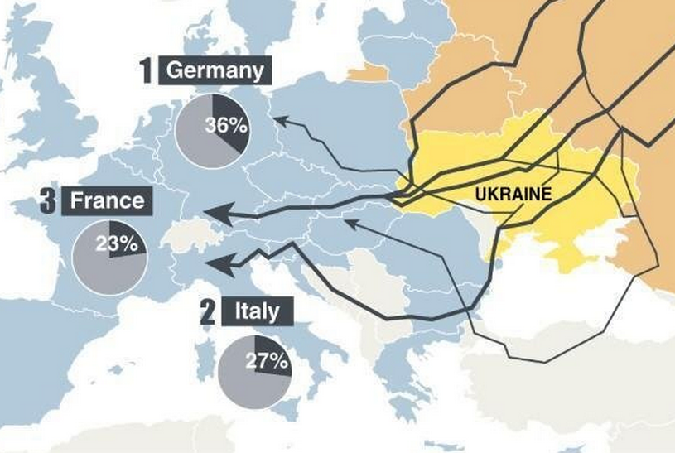
And HERE ARE THE NATURAL GAS PIPELINES FLOWING FROM RUSSIA TO EUROPE…
Of the roughly 160 billion cubic meters of natural gas that Russia sold to Europe last year, which equated to a quarter of European demand, roughly half traveled through Ukrainian pipelines.
Source: Agence France-Presse

Slide 11
4
Natural
Resources

Slide 12
According to Bloomberg News,
“After making a natural gas discovery in
neighboring Romania that may flow
fast enough to supply half of that
country’s consumption, [ExxonMobil]
plans exploration in Bulgaria, Russia and Ukraine.”

Slide 13
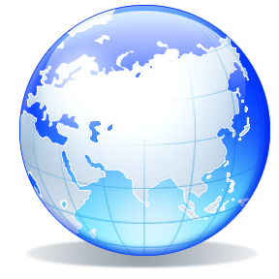
At present, the Black Sea is one of the last frontiers in the oil and natural gas industries. At present, there are fewer than 100 wells drilled, compared with more than 7,000 in the North Sea.
Exxon Mobil
is so confident of prospects in the unexplored Black Sea that it was planning to spend $735 million to drill just two deep-water wells off Ukraine’s coast.

Slide 14
5
Agricultural
Resources

Slide 15
Ukraine is considered the
BREADBASKET OF EUROPE

Slide 16
30%
According to Wikipedia, Ukraine possess 30% of the world’s black soil.

Slide 17
6
Military

Slide 18
As I’ve already noted, the Crimean Peninsula is a critically important for Russia’s navy.
Its Black Sea naval fleet is headquartered there, and the peninsula controls entry to and egress from the Sea of Azoz.
To make matters worse for Russia, the majority of the Black Sea coastline is held by NATO allies -- that is, Russia’s geopolitical adversaries.
“Put simply, without a naval base in Crimea. Russia is finished as a global military power.”
- Greg Satell, Forbes

Slide 19
7
History

Slide 20
Aside from the present and future significance of Ukraine, the country also
“looms LARGE in Russian history.”
“It was the site of THE CRIMEAN WAR fought in the 1850’s against the French, British, and Ottoman Empire. Although Russia lost, the bravery of its soldiers is still a source of Russian pride, MUCH LIKE THE ALAMO IN TEXAS.”
- Greg Satell, Forbes
Remember the Alamo Crimean Peninsula!!!!

Slide 21
8
Geopolitical
Ambitions

Slide 22
“Without Ukraine, Russia ceases to be a Eurasian empire.”
- Zbigniew Brzezinski

Slide 23
9
It worked before…

Slide 24
Remember when Russia invaded Georgia in 2008 -- the country, that is?

Slide 25
10
No consequences

Slide 26
Last but not least, the consequences of invading Ukraine are likely to be de minimis.
In the first case, the Ukrainian army is no match for Russian military might.
And in the second case, the Western world, and particularly the United States, appear extremely reluctant to intervene given the recent past – Afghanistan, Iraq, Libya, Syria, Egypt – and power of the potential adversary – Russia.
Not Vladimir Putin

